Slide 1
Breaking STEM Stereotypes: Insights from Diverse Student Experiences at an Urban MSI in NYC
Fadel Ismail, Krystal Reynoso, Daniela Avila, & Dr. Maria Isabel Roldos, DrPH
AHSIE Conference Spring 2025

Slide 2
Abstract
Thesis Defense
This study challenges the rigid narratives often associated with STEM, which can make students feel that only the "best of the best" belong or that asking for help signals weakness. Conducted at an urban Hispanic-Serving Institution in NYC, this research centers student voices to reveal the unique challenges, motivations, and strengths they bring to STEM. Through peer-to-peer interviews with students from diverse backgrounds, we identified key themes, including the importance of time management support, diverse mentors, and breaking down stereotypes. Our findings show that representation and authentic support make a significant impact on student success. This work emphasizes the need for inclusive environments where every student feels they belong in STEM and provides insights HSIs can use to create tailored supportive solutions.

Slide 3
Thesis Defense
Why is diversity in STEM important?
It is well established that diversity of perspectives, ideas, and priorities from varied backgrounds, experiences, and cultures shape science. (1).
U.S. philosopher Thomas S. Kuhn proposed in his iconic book, The Structure of Scientific Revolutions (1962), that the prevailing view of progress in science in which science advances results from the "development-by-accumulation" of accepted facts and theories. (2) This premise has been reviewed and ratified by social scientists, philosophers, and scientists from around the world. (3)
Medical advances and new technologies have allowed Americans to live longer and healthier lives for the past century. These advances, however, have not helped all Americans equally, and disparities persist, disproportionately affecting racial and ethnic minority populations, individuals of less privileged socioeconomic status (SES), underserved rural residents, sexual and gender minorities (SGMs), immigrants, and subpopulations that are characterized by two or more of these descriptions.
(1) Ferrini-Mundy J. Driven by Diversity. Science. 2013;340(6130):278-.
(2) Kuhn TS. The structure of scientific revolutions. 50th anniversary. Argument: Biannual Philosophical Journal. 2013;3(2):539–43-–43.
(3) Kindi V, Arabatzis T. Kuhn's The structure of scientific revolutions revisited: Routledge; 2013.

Slide 4
Common Stereotypes in STEM
STEM is for White and Asian Men (1)
STEM Requires Innate Genius (2)
STEM is a Pure Meritocracy
The "Weed-Out" Culture is Necessary (3)
STEM is Objective and Apolitical
STEM is Separate from Culture and Identity (4)
(1) Allen, D., Dancy, M., Stearns, E., Mickelson, R., & Bottia, M. (2022). Racism, sexism and disconnection: Contrasting experiences of Black women in STEM before and after transfer from community college. International Journal of STEM Education, 9(1), 20.
(2) Covarrubias, R., Laiduc, G., & Valle, I. (2019). Growth messages increase help-seeking and performance for women in STEM. Group Processes & Intergroup Relations, 22(3), 434– 451. https://doi.org/10.1177/1368430218802958
(3) Weston, T. J., Seymour, E., Koch, A. K., & Drake, B. M. (2019). Weed-out classes and their consequences. In E. Seymour & A.-B. Hunter (Eds.), Talking about leaving revisited: 288 Community College Review 52(3) Persistence, relocation, and loss in undergraduate STEM education (pp. 197–243). Springer International Publishing. https://doi.org/10.1007/978-3-030-25304-2_7
(4) Rodriguez, S. L., Cunningham, K., & Jordan, A. (2017). What a scientist looks like: How community colleges can utilize and enhance science identity development as a means to improve success for women of color. Community College Journal of Research and Practice, 41(4– 5), 232–238. https://doi.org/10.1080/10668926.2016.1251354

Slide 5
Recent data by the National Center of Education Statistics (2018) indicate that nearly 60% of bachelor’s degrees in STEM were awarded to White students, while only 15% were awarded to Latinx students and 9% to African American students.
In the U.S., Hispanics, African Americans, and American Indians and/or Alaska natives make up close to 30% of the general population, and yet, less than 10% of biomedical workforce is from a racial and ethnic minority (National Science Board, 2020).

Slide 6

Why are stereotypes in STEM detrimental?
What is one way institutions can make STEM more inclusive?

Slide 7
What is the role of MSIs and HSIs in STEM education?
Thesis Defense
Create an equitable learning environment that will be conducive to successful, academically prepared students who are adept and equipped with the necessary skills to enter STEM career pathways.
MSIs often create nurturing academic settings that cater to the unique cultural and educational needs of their students.
Fewer studies have studied the relationship between the background of the scientific workforce and the type of science, population, and instruction focus; and even less studied, is the role institutional structures that support this science.

Slide 8

How many of you attend an MSI or HSI? Let’s see by a show of hands!
How has your institution supported or challenged your journey in STEM?
Thesis Defense

Slide 9
What is the objective of this research?
Thesis Defense
The purpose of this project is to ask currently enrolled students at an Urban public minority serving institution in the Bronx in STEM-related majors about their perceptions, motivations, and barriers to enrolling, staying enrolled, and graduating in these fields.
Key Research Questions
How do students at an urban MSI perceive STEM stereotypes?
What challenges and opportunities do they encounter in STEM fields?
How does the MSI environment influence their STEM identity and persistence?
Hypothesis
MSI students challenge STEM stereotypes through lived experiences and strong institutional support.

Slide 10

Methodology
Thesis Defense
Study Approach:
Qualitative research using peer-to-peer interviews.
Focused on student experiences, motivations, and barriers in STEM.
Participants:
15 STEM students from Biology, Chemistry, Mathematics, and Health Sciences.
Diverse representation in terms of gender, race, major, and career goals.
Interview Structure:
Designed to resemble informal conversations to encourage authenticity.
Allowed students to share personal insights without feeling pressured.
Created a comfortable and trusting environment for open discussion.
Intersectional Lens:
Considered how background, culture, and expectations shape student experiences.
Identified barriers unique to diverse student populations in STEM.
Data Analysis:
Thematic analysis to identify common patterns across interviews.
Themes were thoroughly discussed and validated collectively to minimize bias.
Ensured the student voice remained central in findings and recommendations.

Slide 11
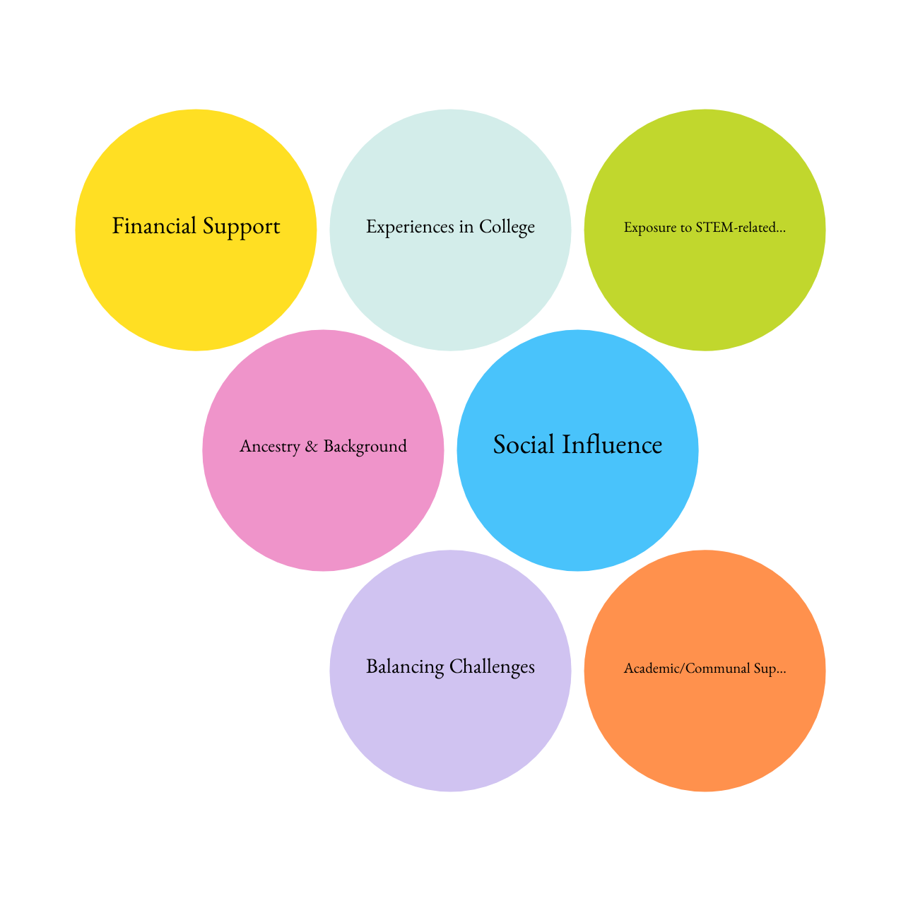
Findings
Content Analyses revealed the following categories of discussion on barriers and perceptions of participants:

Slide 12



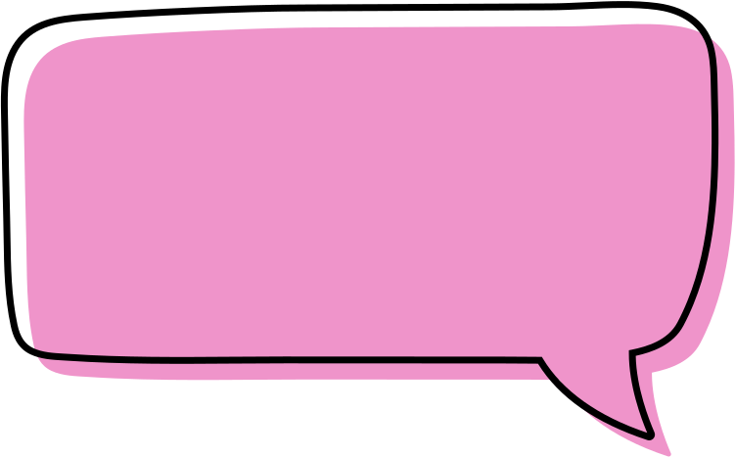
"I use more office hours, and I use the tutoring center. With the professors, the TAs."
(203 Bailey)
"Study groups, especially with friends, have been the best... They’ve been really helpful."​ (202 Josh Parker)
"One challenge I faced was during general chemistry... I went away for a certain amount of time... Because of that, I wasn't able to understand the concepts in the beginning of the class... the professor would email me and tell me which videos to watch and what I was supposed to be doing. That helped me along, or else I think I would have failed that class very badly."
(301 Robert McAllen)
Absolutely like, I don't think there has been a time where a professor has shut me down just from speaking from my experience, because I've heard, like others from peers, maybe. But from my experience, I've never really been shut down from any learning opportunity. If anything, they always encouraged it. And again, that's very motivating. That was a factor in motivating me as a biology major and in my department. (304 - Meredith)

Slide 13
Ancestry & Background (Motivation and Family Sacrifice)
Parental Sacrifices and High Expectations
"They [my parents] have very high expectations for me because, you know, they sacrificed everything to come here so that their children could have the life that they didn’t have, so they always make sure that I'm doing well in school, and they… made it clear to me that education is number one."​ (201- Jaiden)
First-Generation College Experience & Lack of Parental Guidance
"Essentially, as a first-generation college student, parents don't really know what college means, and the value of college. As all they can really see is, as long as you have a job, that’s all that really matters to us."​ (103- Random)
Cultural and Gender Expectations
"As far as they tell me, they're very proud of me, but they're always telling me not to do it because, as a woman, it's going to be very difficult for me to do that and take care of the house." (301- Robert McAllen)
Role Models and Family Influence on STEM Motivation
"My uncle, actually, he's an engineer. And that kind of inspired me, because I think he's the only one that went to college on my mom's side of the family. So that really inspired me to pursue a degree in STEM."​ (104- Finn)

Slide 14
Ancestry & Background (Motivation and Family Sacrifice)
IMPLICATIONS:
First-Generation Support Services
Seek out support services that help with academic expectations and career planning—your college likely has programs designed for first-generation students.
Financial Aid Awareness & Assistance
Don’t miss out on financial aid! Attend workshops, talk to financial aid advisors, and explore scholarship opportunities to maximize your funding.
Culturally Inclusive Career Counseling
Connect with career advisors who understand your background and can help you navigate family expectations and career paths, especially in fields requiring advanced degrees.
Gender-Specific Support in STEM
Get involved in mentorship programs and support networks that empower women in STEM and address challenges like gender bias and representation.
Leveraging Family Influence for STEM Motivation
Share your STEM goals with your family and seek mentors from similar backgrounds who can reinforce the value of your career path.

Slide 15
Influence of Family and Social Environment on Career Choices
Exposure to STEM Through Family Members
"My uncle, actually, he's an engineer. And that kind of inspired me, because I think he's the only one that went to college on my mom's side of the family. So that really inspired me to pursue a degree in STEM."​ (104- Finn)
Peer Influence and Support Networks
"The people I surround myself with. A lot of them are STEM-oriented... we have similar interests, and when other like-minded individuals are working towards it, it makes you want to work towards it as well." (300- April)
Role of Professors, Advisors, and Mentors
"Some professors go out of their way to make sure you understand the material. My organic chemistry professor, in particular, was a huge help. I went to every office hour." (304- Meredith)

Slide 16
Influence of Family and Social Environment on Career Choices
IMPLICATIONS:
Enhancing Mentorship and Peer Networks
Connecting with professionals in STEM can help you stay engaged and motivated in your studies while strengthening your chances of success.
Peer-led study groups and mentorship initiatives should be expanded.
Faculty-Driven Support and Advising
Show up for yourself in every way! This includes going to professors and advisors to ensure you remain on track, especially for challenging STEM courses.

Slide 17
Challenges Time Management and Balancing Responsibilities
Balancing Work, School, and Life is Overwhelming
"I was taking 18 credits, and I was working 2 jobs, and it was crazy. I was working at Staples, and then I was also tutoring, and it was just a lot... I would have class one day, and then I would leave and do my shift at Staples, and then... tutoring right after."
Impact of Jobs on Academic Performance
Both of [my jobs] take time, and one of them takes more brain energy than the other... but still, sometimes it takes a toll on your mind."
Burnout and Procrastination
"Sometimes midterm season, final season with all the tutoring and stuff, I felt like my brain was fried... you’re processing so much information teaching information, but then you gotta study for another exam."
Managing STEM Coursework Takes Significant Time
"Understanding the course itself is quite difficult. Chemistry is not exactly easy... if you’re a student who works and does a lot of other things, it’s hard to keep balance."

Slide 18
Challenges Time Management and Balancing Responsibilities
IMPLICATIONS:
Need for More Flexible Scheduling and Support
If possible, be open to both evening and online classes to maintain a good balance between work and school.
Joining study groups and peer-led tutoring can make managing your STEM coursework easier and help you succeed.
More Resources for Time Management and Mental Health
Attend workshops on study skills, time management, and stress reduction to stay on top of your workload and reduce stress.
Make sure you’re aware of the mental health resources your college offers to help prevent burnout and stay balanced.
Rethinking Job and Study Balance
Look for on-campus STEM jobs like TA or tutoring positions—they can boost your academic success while helping you earn money.
Your school should offer more paid research opportunities, so you don’t have to choose between gaining experience and making an income.

Slide 19
Expectations of STEM Students by STEM Students
High Academic and Workload Expectations
The Expectation to Gain Research and Extracurricular Experience
"That’s kind of like STEM 101. You talk to a STEM major, they’re all going to say is how hard it is... trying to balance life and school at the same time."
"Doing extracurriculars, in addition to my college program, I get to meet a lot of people. I get to network... I still feel like I need to do more volunteering, more research to get into med school—that’s my goal."
Self-Imposed Pressure and Competition
"I expect a lot from myself because I know what I’m capable of... Even if I struggle, I feel like I have to keep proving that I belong here."
"I think I can definitely like, create a lot of pressure for myself... I also doubt the ability to get where I want to go... those doubts, and also those comparisons can oftentimes... shoot me down."

Slide 20
Expectations of STEM Students by STEM Students
IMPLICATIONS:
More Mental Health and Stress Management Support Needed.
STEM can be intense, but your well-being matters. Take advantage of campus mental health resources, attend stress management workshops, and build resilience.
Remember, one or two bad grades don’t define your future!
Balancing Research & Extracurriculars Without Burnout
Research and extracurriculars are great for experience, but you don’t have to do everything at once. Seek structured opportunities that fit your schedule, and focus on quality over quantity to avoid burnout.

Slide 21
Exposure/Accessibility to STEM-related Extracurriculars; Mentorship & Outreach; Academic/Communal Support at Lehman
Strong Mentorship and Academic Support Exist but Are Underutilized
Some Students Feel a Strong Sense of Community at Lehman
"I think for the most part, the professors are really good. They care a lot about the students and how they perform in their class. You can tell it's not just because they want a good rating or review, it’s because they genuinely want you to succeed."
"I’m very comfortable at Lehman. It’s close to my work and house, but it’s not only that. I’m comfortable with the professors that I’ve had. I’m comfortable with my peers. I’ve created a good group here."
Research and Extracurricular Opportunities Are Available but Need More Awareness
"I feel we’re all quite the same. We’re all struggling with the same things, either with coursework, life, or just work in general. So, I feel like we can all get along and bond on that aspect."
"April: Internships? Not... Oh, yeah, through Lehman. I’ve done with the professor. I got paid a stipend for just doing my regular coursework. Like Chem 391 is the research course. And so they gave me—it was like over a thousand-dollar stipend for just doing my research."
Students Rely on Peer Networks for Academic Success
"More offers for research. I think a lot of students like research, more so than maybe the actual classes and stuff... I think all departments should offer more opportunities for research and really advocate for them."
"I like to surround myself with peers that have more effective studying techniques... The way I study best is around people. If I study alone, I feel like I’ll only study what I know. I like to take from what other people do."

Slide 22
Exposure/Accessibility to STEM-related Extracurriculars; Mentorship & Outreach; Academic/Communal Support
IMPLICATIONS:
FINDING RESEARCH & INTERNSHIP OPPORTUNITIES
Not sure where to start? Talk to professors, advisors, and career services to learn about research and internship programs.
Be proactive—opportunities exist, but you may need to seek them out!
Building Connections Through Peer Mentoring
Study groups and peer mentors can make tough STEM courses more manageable.
If you’re struggling, look for mentoring programs or create a study group to learn from others and share strategies.

Slide 23

How to Challenge STEM Stereotypes for Students
Normalize help-seeking, foster collaboration, and ensure institutions provide culturally sensitive support.
Take advantage of resources. Don’t be afraid to reach out!!
Support each other (build study groups, share opportunities, and encourage your peers.
Advocate. Be the catalyst for change!
STEM NEEDS YOU!

Slide 24
How to Challenge STEM Stereotypes for Educators
Normalize help-seeking as part of learning.
Encourage collaborative learning environments (top-down and bottom-up approaches).
Prioritize building strong institutional support systems that are culturally sensitive and equitable.
“STEM educators should normalize and encourage pro-social and egalitarian norms and practices. For instance, many minoritized students pursue STEM to give back to their communities or respond to broader social issues.
Choi, Y. H. (2024). Master Narratives and Resistance Narratives: How Women of Color on Community College STEM Education Pathways Push Back. Community College Review, 52(3), 263-288. https://doi.org/10.1177/00915521241238746

Slide 25
Insights
Would anyone like to share any reflections they have learned?

Slide 26
Conclusion
The purpose of this research study is to explore students enrolled in STEM-related majors about their perceptions, motivations, and barriers to enrolling, staying enrolled, and graduating in these fields.
This research mechanism has the potential to gather evidence about how to address the barriers that are preventing scientific investment in minority communities. We encourage you all to take these insights and implement findings that you have learned today to create the change we desire to create equitable change in STEM.

Slide 27
References
Ferrini-Mundy J. Driven by Diversity. Science. 2013;340(6130):278-.
Kuhn TS. The structure of scientific revolutions. 50th anniversary. Argument: Biannual Philosophical Journal. 2013;3(2):539–43-–43.
Kindi V, Arabatzis T. Kuhn's The structure of scientific revolutions revisited: Routledge; 2013.
Bharmal N, Derose KP, Felician M, Weden MM. Understanding the upstream social determinants of health. California: RAND. 2015:1-18.
Brownson RC, Kreuter MW, Arrington BA, True WR. Translating scientific discoveries into public health action: how can schools of public health move us forward? Public Health Rep. 2006;121(1):97
Oxman AD, Thomson MA, Davis DA, Haynes RB. No magic bullets: a systematic review of 102 trials of interventions to improve professional practice. Cmaj. 1995;153(10):1423-31.
Elias RR, Jutte DP, Moore A. Exploring consensus across sectors for measuring the social determinants of health. SSM - population health. 2019;7:100395.
Frieden TR, Varghese CV, Kishore SP, Campbell NRC, Moran AE, Padwal R, et al. Scaling up effective treatment of hypertension—A pathfinder for universal health coverage. The Journal of Clinical Hypertension. 2019;21(10):1442-9

Slide 28
AHSIE Conference Spring 2025
Thank you for your audience!
Fadel Ismail, Krystal Reynoso, Daniela Avila, with Dr. Maria Isabel Roldos-Prosser, DrPH
CUNY Institute for Health Equity (CIHE)
CUNY Lehman College

