Slide 1
Octave

Slide 2
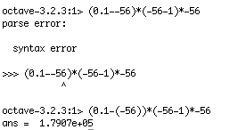
Getting Started
Arithmetic is as usual:
  What would (a-V)(V-1)V be for a=0.1 and V=-56?
  Multiplication is *, division is /

Slide 3
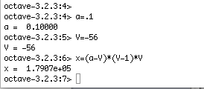
Variables
Variables are as usual and assignment is as usual:

Slide 4

Arrays
Arrays are the basic data type
  Semi-colons separate rows
  Commas separate individual numbers in a row

Slide 5
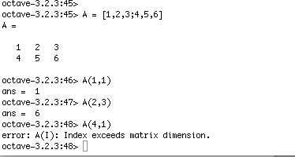
Addressing array elements

Slide 6
Array exercises
Array operations are what they should be
  Define any array and the identity, and multiply them
  Divide the identity by an array, assigning to a variable (this should be the array inverse)
  Multiply the array and its inverse

Slide 7
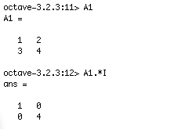
Array operations
But there are also element-wise operations
  + is always element-wise
  .* is element-wise multiplication

Slide 8
Useful built-in arrays
Try these:
i=1:1:10
i=1:2:10
ones(10)
zeros(1,10)
eye(10)
eye(5,10)

Slide 9
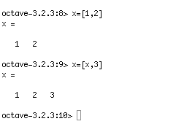
Adding to vectors

Slide 10
Plotting
Uses gnuplot
The command “plot(x, y)” lets you plot values of a vector x against values of a vector y

Slide 11
Plotting exercises
Plot x against sin(x) for x=pi/16, 2*pi/16, … , 2*pi
Plot cos(x) against sin(x) for the same values

Slide 12
Functions
function <retval> = <name>(<arglist>)
<stmt>
<stmt>
…
endfunction

Slide 13
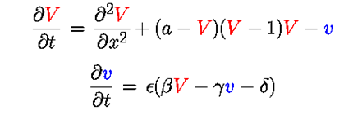
Fitzhugh-Nagumo
∂V/∂t = (a-V)(V-1)V – v
∂v/∂t = ϵ(βV-γv-δ)

Slide 14
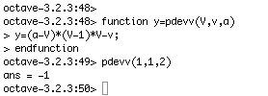

Slide 15
Before more functions… editing
addpath(<pathToFunctions>)
  <pathToFunctions> = “/Users/User/octave”
Edit and save functions in a separate window
  Pick your favorite text editor (don’t use Word)
Octave will search its path for functions you use

Slide 16
Exercises
Write functions to compute:
∂V/∂t = (a-V)(V-1)V – v
∂v/∂t = ϵ(βV-γv-δ)

Slide 17
Parameter values
a=0.1
b=0.5
g=1
d=0
e=0.01

Slide 18
Numerical integration
f(t+Δt) = f(t) + dt*∂f/∂t
Given V(0) =0 and v(0) = 0,
let’s plot (t, V(t)) and (t,v(t))

Slide 19
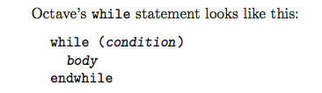
Loops

Slide 20

Loops

Slide 21

Loops
A simple version of expression is a vector; var takes on each value in the vector in turn.

Slide 22
Numerical Integration
V(t+Δt) = V(t) + Δt(∂V/∂t)
= V(t) + Δt((a-V)(V-1)V – v)
v(t+Δt) = v(t) + Δt(∂v/∂t)
= v(t) + Δt(ϵ(βV-γv-δ))
V = V + dt*(V*(a-V)*(V-1.0)-v)
v = v + dt*(eps*(beta*V-gamma*v-delta))

Slide 23
Exercise
Write a function to compute vectors of values for V and v, from time 0 to time 200.
Plot them against time t.
Plot them against each other.
Provide a stimulus at some point plot the result

